Slide 1
Wildcards
Notes:
This is the twelfth presentation in the 18-part series for CWB training. The following slides cover how to utilize wildcards to capture unique data.

Slide 2
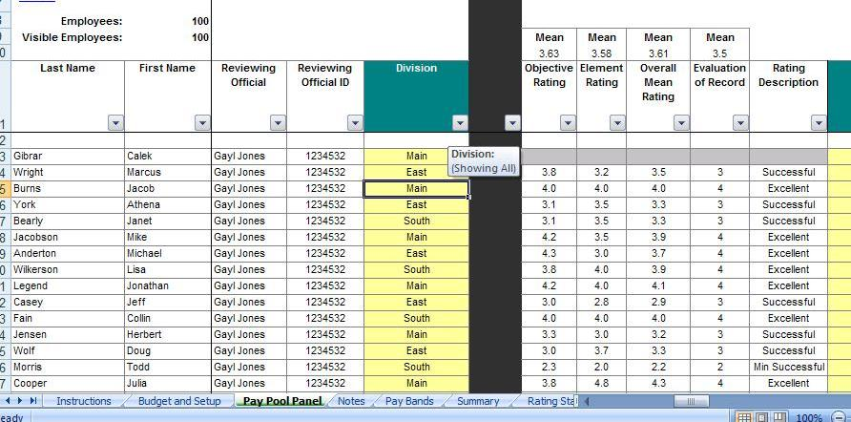
Using Wildcards
There are 14 wildcard columns on the Pay Pool Panel worksheet
Type in new header names to show the column definition
Type in values or formulas in any or all cells in the column
Notes:
Use Wildcards to track unique data (customized data) needed for analysis or reporting statistics based on your organizations needs.

Slide 3
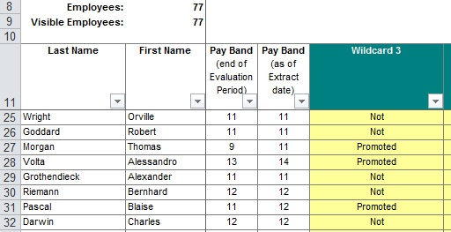
Using Wildcards, cont’d.
Populate a wildcard column with a formula prior to import by typing in Row 13 – any formulas should reference Row 13 in the column in question
Then import as normal. Note that any values in a wildcard field in the import file will override your pre-import formulas.
Notes:
This slide shows how to use formulas in your wildcard columns.

Slide 4
To continue CWB training, view next presentation
“DQI and SQI Decisions”
Notes:
This concludes the twelfth presentation in the 18-part series for CWB training. To continue training, view the next Presentation, entitled DQI and SQI Decisions.

